Slide 1

PROJECT TITLE :IMDB Movies
SQL data analysis and key findings:
Presented by: Chilumakuri Hemalatha
Course : Data Analyst

Slide 2
CONCEPTS:
Introduction
Project Objectives
Project Overview
Dataset Description
Database Connection
SQL Queries: Data Analysis and Results
SQL Functions and Keywords
Conclusion

Slide 3
Introduction:
This project is about learning the movie industry with SQL analysis.
The primary aim is to explore and analyse information about movies.
It is useful for recognizing popular movies and successful directors.
The analysis provides useful insights into movie performance and
director achievements.

Slide 4
Project objectives:
Retrieve and explore movie and director information.
Identify the most popular and highest-revenue movies.
Analyse female directors and director details.
Find directors who have directed the most movies.
Identify the most bankable directors based on total movie revenue.
Use SQL queries, filtering, sorting, grouping and joins to analyse the data.
Tools:
1.MySql
2.MySql workbench
3.Movies dataset
4.Directors dataset

Slide 5
Project overview:
What the two tables contain:
47
1,000
13
5
Movie records
Director records
Movie columns
Director columns
Movies table: original_title, budget, popularity, release_date, revenue, title, vote_average(ratings),
vote_count,overview,tagline,uid, id(director_id renamed to id and ID column dropped).
Directors Table: name, id, gender, uid and department.
The common key is movies.id = directors.id.

Slide 6
How to connect movies and directors
Use the id as the relationship between the two tables
Movies.id
Directors.id
1. Dropped the existing id column from
the Movies table:
alter table movies drop column id;
2. Renamed the director_id column to id in
movies table
alter table movies
rename column director_id to id;
3. Used directors.id as the Primary Key and
movies.id as the Foreign Key to connect both
tables.
select * from directors d1 Inner join
movies m1 on d1.id=m1.id;

Slide 7
SQL Queries:
A) Can you get all data about movies ?
b) How do you get all data about directors?
select * from movies;
select * from directors;
Result: Displays all records and columns from
the Movies table.
Result: Displays all records and columns
from the directors table.

Slide 8
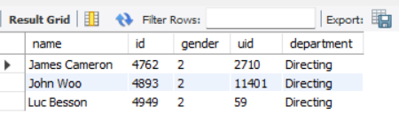
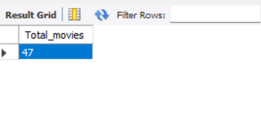
C | Check how many movies are present in IMDB
D| Find these 3 directors: James Cameron ;
Luc Besson ; John Woo
IMDb stands for Internet Movie Database.
select count(*) as Total_movies
from movies;
select *from directors
where name in ("James Cameron" , "Luc Besson" , "John Woo");
Result:
Result:
Counts the total number of movies in the
Movies table(47).
Displays the details of three selected directors:
James Cameron, Luc Besson and John Woo.

Slide 9
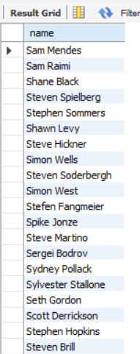
E | Find all directors with name starting with S.
Result:
select name from directors
where name like "S%";
Displays the names of all directors whose names start with the letter 'S’.
The complete query result contains all 88
matching records.

Slide 10
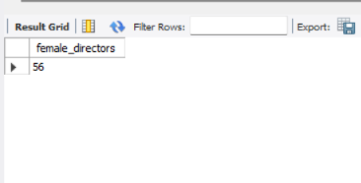
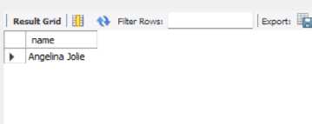
G| Find the name of the 10th first
women directors?
F | Count female directors.
select count(*) as Female_directors_count from directors where gender=1;
select name from directors
where gender=1 order by id limit 9,1;
Result:
Result:
The query counts the total number of female directors(56) in the directors table.
Displays the name of the 10th female directors (Angelina Jolie) from the directors table.

Slide 11
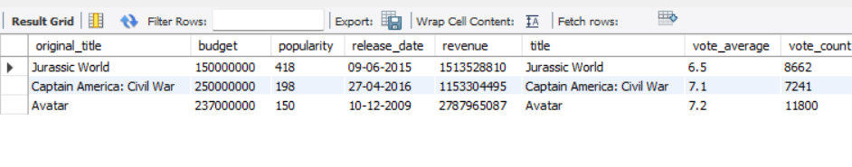
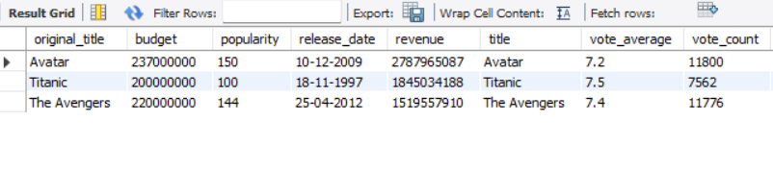
h | What are the 3 most popular movies?
I | What are the 3 most bankable movies?
select * from movies
order by popularity desc limit 3;
select * from movies
order by revenue desc limit 3;
Result:
Result:
Displays the top 3 most popular movies based on
their popularity score.
Displays the top 3 movies that generated the highest revenue.

Slide 12
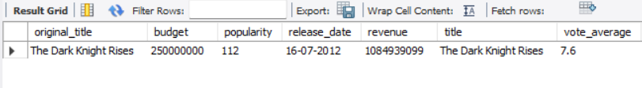

J | What is the most awarded average vote
since the January 1st, 2000?
K | Which movie(s) were directed
by Brenda Chapman?
select * from movieswhere str_to_date(release_date, "%d-%m-%Y")>='2000-01-01'order by vote_average desc limit 1;
select original_title from movies m1inner join directors d1 on m1.id=d1.idwhere name="Brenda Chapman";
Result:
Result:
Identifies the movie released on or after 1 January
2000 with the highest average vote rating.
Displays the movie titles directed by Brenda Chapman.
The Dark Knight Rises is the highest-rated, with an
average rating of 7.6.
No movies were found for director Brenda Chapman
in the given dataset.

Slide 13
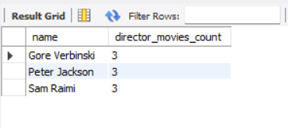
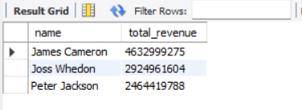
L | Which director made the most movies?
M | Which director is the most bankable?
select name, count(*) as director_movies_count from directors
d1 inner join movies m1 on d1.id=m1.id group by name order by director_movies_count desc limit 3;
select name,sum(revenue) as total_revenue from directors d1inner join movies m1on d1.id=m1.idgroup by name order by total_revenue desc limit 3;
Result:
Result:
The top 3 directors were identified by counting the number of movies directed by each director and ranking them in descending order of movie count.
The total revenue generated by each director was calculated by summing the revenue of their movies and ranking them in descending order to identify the highest revenue-generating directors.

Slide 14
Important SQL keywords used in my project:
SQL keyword | Purpose
SELECT | Retrieves the required columns
COUNT() | Counts the number of movies
SUM() | Calculates total revenue
AS | Assigns an alias to a column
FROM | Specifies the source table
INNER JOIN | Combines directors and movies tables
ON | Defines the join condition
GROUP BY | Groups records by director name
ORDER BY | Sorts the results
DESC | Sorts from highest to lowest
LIMIT | Returns only the top records

Slide 15
CONCLUSION:
This project used SQL to analyse movie and director data and extract meaningful insights.
The analysis identified the most popular movies, highest-revenue movies, top directors by movie count, and most bankable directors.
SQL operations such as joins, filtering, grouping, sorting, and aggregation helped answer key business questions from the dataset.
The project demonstrates how SQL can be used to transform raw data into valuable information for decision-making in the movie industry.

Slide 16
Thank you

